Slide 1
Performance Monitoring, Tuning and Securing SQL Databases in Azure

Slide 2
Table of Contents
Monitoring and Troubleshooting using Intelligent Performance
Performance Recommendations
Automatic Tuning
Query Performance Insight
Performance Overview
Monitoring and Troubleshooting Performance using DMVs and Azure SQL Analytics
Monitoring Singletons, Shared Pool and Managed Instance
Performance using Azure SQL Analytics
Intelligent Insights in Azure SQL Analytics
Industry Leading Security
Data Discovery & Classification
Vulnerability Assessment
Advanced Threat Protection

Slide 3

Intelligent Performance

Slide 4

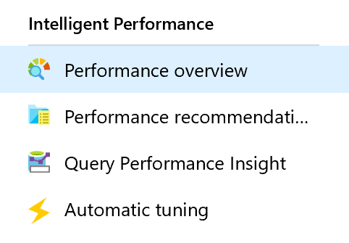
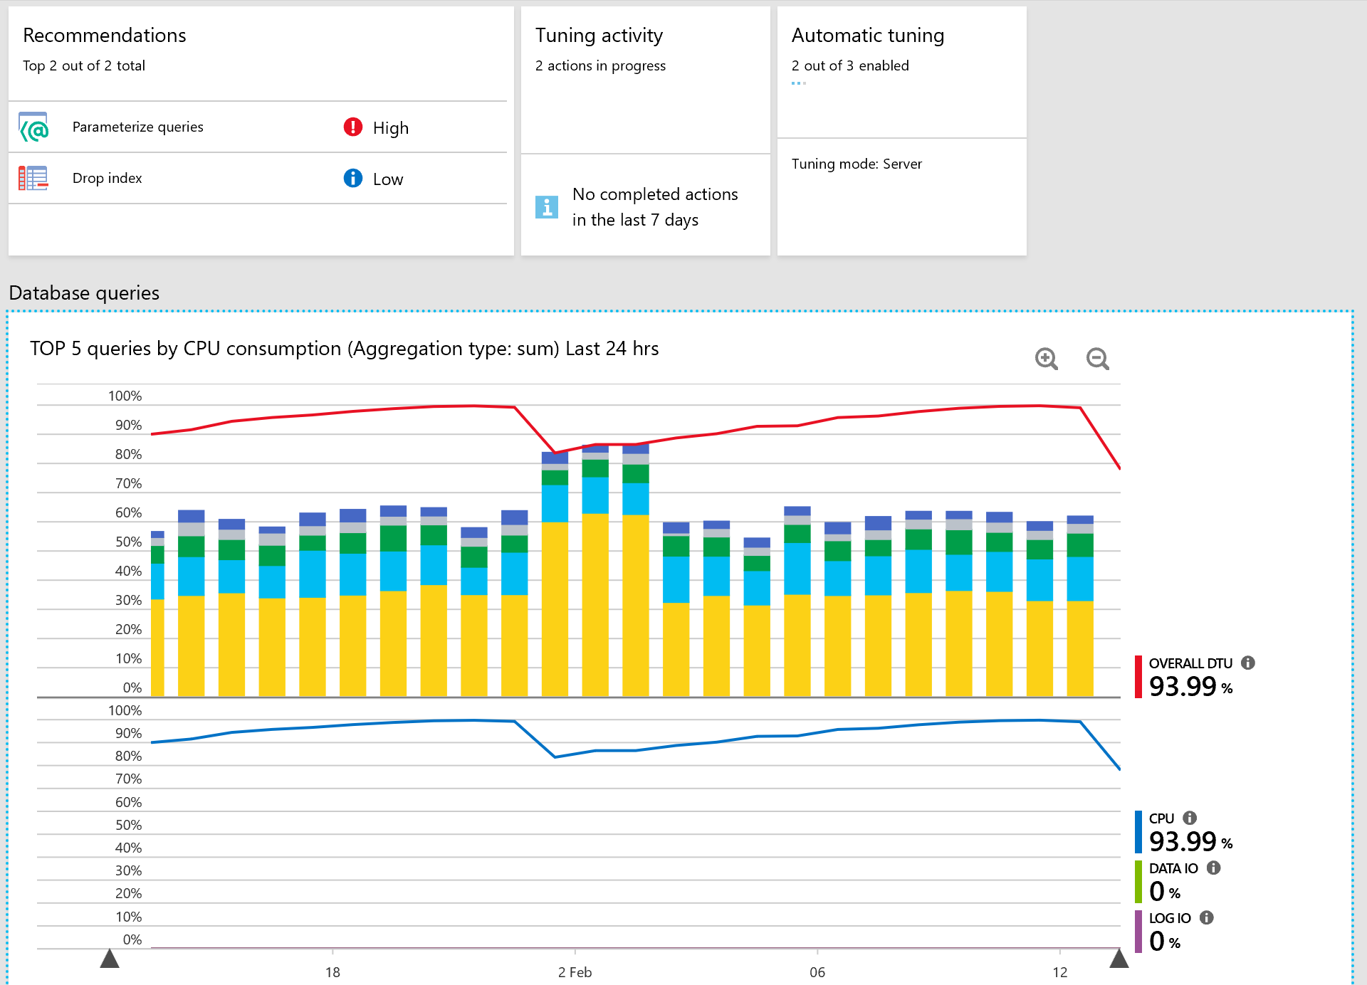
Intelligent Performance – Performance Overview
Azure SQL Database – Single & Elastic Pool

Slide 5
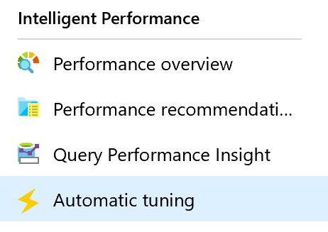
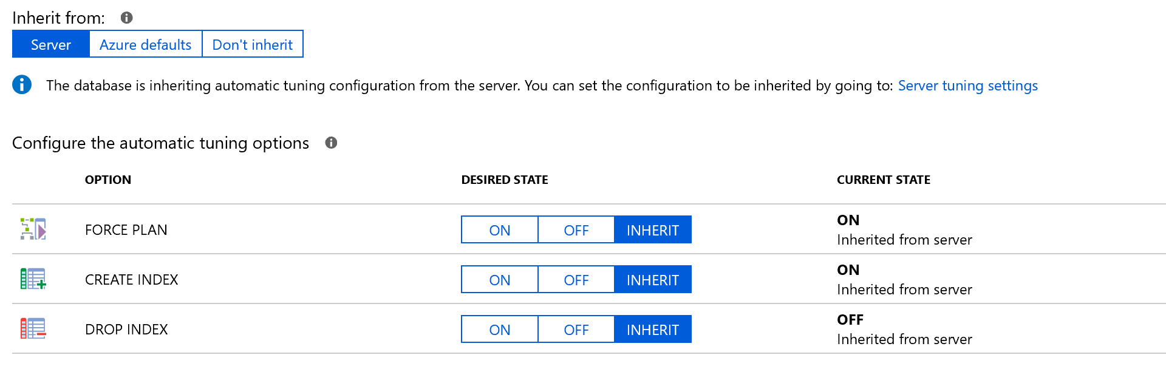
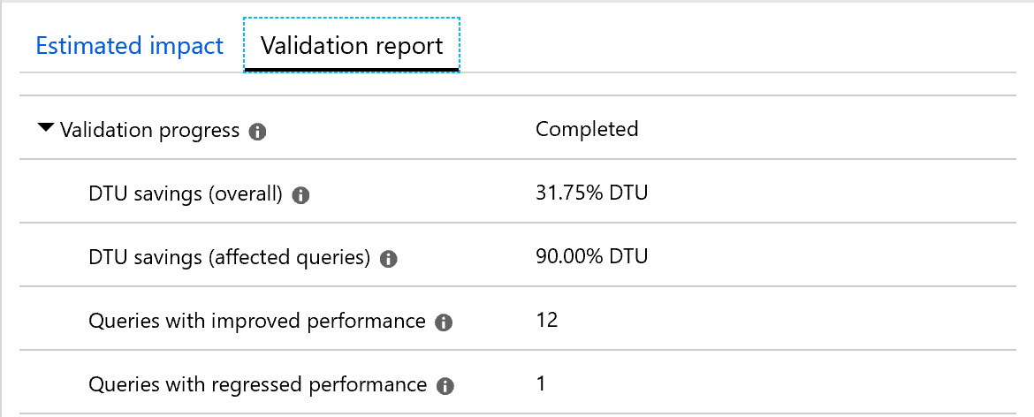
Intelligent Performance – Automatic Tuning
Azure SQL Database – Single & Elastic Pool
Automatic Tuning Options -
Create Index – Identifies and creates Indexes, validates performance improvements and reverts the change if performance degrades
Drop Index – Identifies and drops unused Indexes, validates performance improvements and reverts the change if performance degrades
Force Last Good Plan – Identifies regressed queries due to bad plan and replaces the bad plan with last Good Plan, validates performance improvements and reverts the change if performance does not improve.

Slide 6
DEMO
Automatic Tuning
Notes:
http://automaticplancorrectiondemo.azurewebsites.net/index.html

Slide 7

Monitoring and Troubleshooting

Slide 8
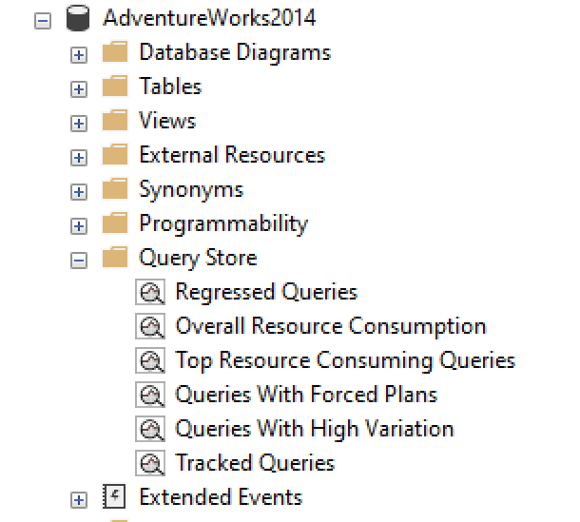
Identify CPU Performance issues using DMVs
Azure SQL Database – Single, Elastic Pool & MI
Monitor performance issues occurring NOW with DMVs.
sys.dm_exec_requests, sys.dm_exec_query_stats and sys.dm_exec_sql_text
sys.dm_os_waiting_tasks
sys.dm_db_resource_stats and sys.resource_stats
sys.elastic_pool_resource_stats^{NEW}
Otherwise, use Query Store to monitor PAST performance issues
sys.query_store_query
sys.query_store_plan
sys.query_store_runtime_stats

Slide 9
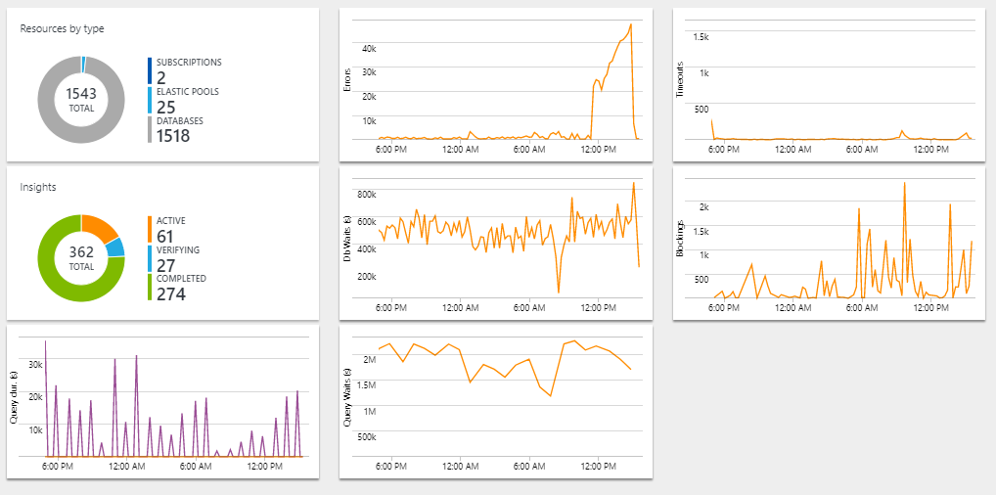
Monitoring with Azure Log Analytics
Azure SQL Database – Single, Elastic Pool & MI
Monitoring Azure SQL Database at scale
Integrated with Operations Management Suite
Monitor entire Azure SQL Database estate across multiple subscriptions
Provides a view into raw telemetry
Monitored activities
Resource usage
Query performance
SQL errors
Timeouts
Blocking
Intelligent insights
Insights into databases performance
Built-in intelligence that continuously monitors database usage
Uses Artificial Intelligence to detect disruptive events that cause poor performance
Generates diagnostic log with intelligent assessment for disruptive events
Performs root cause analysis and provides remediation where possible for performance improvements

Slide 10

TOP TIPS
Automatic tuning is the recommended method to automatically tune some of the most common database performance issues.
Performance Insights is the recommended method for basic Azure SQL Database performance monitoring needs.
Azure SQL Analytics is the recommended method for advanced monitoring of database performance at scale, with built-in intelligence for automated performance troubleshooting.

Slide 11
DEMO
SQL ANALYTICS
Notes:
Log analytics demo

Slide 12

Security

Slide 13
Data Security Challenges - Assume Breach
No organization is immune to data breaches and security incidents
71% of breaches were financially motivated, looking for payment card data, personal information or intellectual properties
34% involved internal actors, while 69% perpetrated by outsiders
Verizon Data Breach Investigation Report 2019
$3trillion
Yearly estimated market value destroyed from cybercrime industry
Discover
Sensitive data
Misconfigurations
Compliance
Protect
Access control
Data encryption
Obfuscation
Detect
Query injection
Credential theft/leak
Data leakage/extraction

Slide 14
Industry-Leading Security
Azure SQL Database – Single, Elastic Pool and MI
✓
Data Protection
Encryption-at-rest Transparent data encryption (TDE)
Backup encryption
Encryption in transit Transport Layer Security (TLS 1.2) Client-side encryption Always Encrypted
Access Management
✓
Database access Firewall
SQL Server Logins
Azure Active Directory Authentication
Roles and permissions
Schemas
Application access Row-Level Security Dynamic Data Masking
✓
Advanced Data Security
Proactive monitoring Auditing
And Data Discovery and Classification
Security Management Threat detection
Vulnerability Assessment
SECURITY

Slide 15
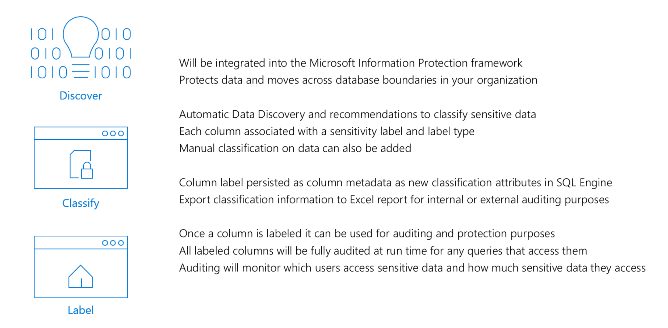
Data Discovery & Classification (Information Protection)
https://docs.microsoft.com/en-us/azure/sql-database/sql-advanced-threat-protection

Slide 16
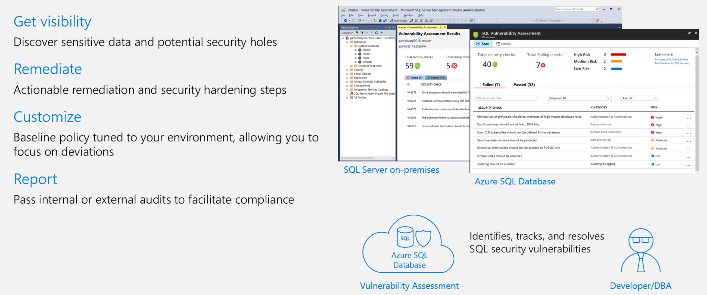
Vulnerability Assessment
https://docs.microsoft.com/en-us/azure/sql-database/sql-advanced-threat-protection

Slide 17
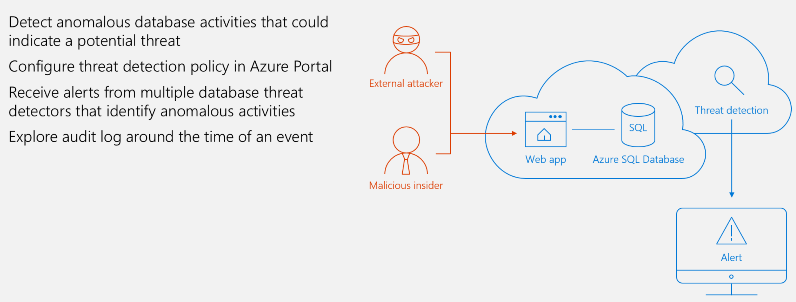
Threat Detection
https://docs.microsoft.com/en-us/azure/sql-database/sql-advanced-threat-protection

Slide 18




























The largest compliance portfolio in the industry
ISO 27001
SOC 1 Type 2
SOC 2 Type 2
PCI DSS Level 1
Cloud Controls Matrix
ISO 27018
Content Delivery and Security Association
Shared
Assessments
FedRAMP JAB P-ATO
HIPAA / HITECH
FIPS 140-2
21 CFR
Part 11
FERPA
DISA Level 2
CJIS
IRS 1075
ITAR-ready
Section 508 VPAT
European Union
Model Clauses
EU Safe Harbor
United Kingdom
G-Cloud
China Multi
Layer Protection Scheme
China
GB 18030
China
CCCPPF
Singapore
MTCS Level 3
Australian Signals
Directorate
New Zealand
GCIO
Japan
Financial Services
ENISA
IAF
Notes:
1bn investment in security
Microsoft Red team blue team

Slide 19
DEMO
Advanced Threat Protection
Data Discovery and Classification
Transparent Data Encryption

Slide 20
APPENDIX

Slide 21
Identify CPU Performance issues using DMVs
Azure SQL Database – Single, Elastic Pool & MI
For issues occuring right now use sys.dm_exec_requests and sys.dm_exec_sql_text. Otherwise use Query Store to determine root cause analysis.
Below returns the TOP 10 query hashes that are consumng CPU
PRINT '-- top 10 Active CPU Consuming Queries (aggregated)--'; SELECT TOP 10 GETDATE() runtime, * FROM(SELECT query_stats.query_hash, SUM(query_stats.cpu_time) 'Total_Request_Cpu_Time_Ms', SUM(logical_reads) 'Total_Request_Logical_Reads', MIN(start_time) 'Earliest_Request_start_Time', COUNT(*) 'Number_Of_Requests', SUBSTRING(REPLACE(REPLACE(MIN(query_stats.statement_text), CHAR(10), ' '), CHAR(13), ' '), 1, 256) AS "Statement_Text" FROM(SELECT req.*, SUBSTRING(ST.text, (req.statement_start_offset / 2)+1, ((CASE statement_end_offset WHEN -1 THEN DATALENGTH(ST.text)ELSE req.statement_end_offset END-req.statement_start_offset)/ 2)+1) AS statement_text FROM sys.dm_exec_requests AS req CROSS APPLY sys.dm_exec_sql_text(req.sql_handle) AS ST ) AS query_stats GROUP BY query_hash) AS t ORDER BY Total_Request_Cpu_Time_Ms DESC;
Below returns the TOP 10 long running queries that consume CPU
PRINT '--top 10 Active CPU Consuming Queries by sessions--'; SELECT TOP 10 req.session_id, req.start_time, cpu_time 'cpu_time_ms', OBJECT_NAME(ST.objectid, ST.dbid) 'ObjectName', SUBSTRING(REPLACE(REPLACE(SUBSTRING(ST.text, (req.statement_start_offset / 2)+1, ((CASE statement_end_offset WHEN -1 THEN DATALENGTH(ST.text)ELSE req.statement_end_offset END-req.statement_start_offset)/ 2)+1), CHAR(10), ' '), CHAR(13), ' '), 1, 512) AS statement_text FROM sys.dm_exec_requests AS req CROSS APPLY sys.dm_exec_sql_text(req.sql_handle) AS ST ORDER BY cpu_time DESC; GO

Slide 22
Monitoring Resources using DMVs
sys.dm_db_resource_stats
Can get CPU, IO and Memory consumption
Captures data every 15 seconds
History maintained for an hour
Data returned is percentage of maximum allowed limits of for the service tier
If the % returned are consistently higher then performance tune the queries or look to move to higher tier
sys.resource_stats
Captures data every 5 mins
History maintained for 14 days
View exists in Master database
If the % returned are consistently higher then performance tune the queries or look to move to higher tier
Azure SQL Database – Single, Elastic Pool & MI
Below query returns the average and maximum values for CPU %, data and log I/O, and memory consumption over the last hour.
SELECT
AVG(avg_cpu_percent) AS 'Average CPU Utilization In %',
MAX(avg_cpu_percent) AS 'Maximum CPU Utilization In %',
AVG(avg_data_io_percent) AS 'Average Data IO In %',
MAX(avg_data_io_percent) AS 'Maximum Data IO In %',
AVG(avg_log_write_percent) AS 'Average Log Write I/O In %',
MAX(avg_log_write_percent) AS 'Maximum Log Write I/O In %',
AVG(avg_memory_usage_percent) AS 'Average Memory Usage In %',
MAX(avg_memory_usage_percent) AS 'Maximum Memory Usage In %'
FROM sys.dm_db_resource_stats;
Below query returns the average and maximum values for CPU %, data and log I/O over the last 7 days.
SELECT database_name,
AVG(avg_cpu_percent) AS 'Average CPU Utilization In %',
MAX(avg_cpu_percent) AS 'Maximum CPU Utilization In %',
AVG(avg_data_io_percent) AS 'Average Data IO In %',
MAX(avg_data_io_percent) AS 'Maximum Data IO In %',
AVG(avg_log_write_percent) AS 'Average Log Write I/O In %',
MAX(avg_log_write_percent) AS 'Maximum Log Write I/O In %'
FROM sys.resource_stats
WHERE END_TIME > DATEADD(day, -7, GETUTCDATE())
GROUP BY database_name;
Below query returns average DTU consumption as a percentage of maximum DTU limit for the service tier
SELECT end_time AS [Time],
(SELECT Max(v)
FROM (VALUES (avg_cpu_percent), (avg_data_io_percent), (avg_log_write_percent)) AS
value(v)) AS [avg_DTU_percent]
FROM sys.dm_db_resource_stats;

Slide 23
Monitoring Resources for Elastic Pools using DMVs
sys.elastic_pool_resource_stats
Can get CPU, IO, Log, storage consumption and concurrent session
Captures data every 15 seconds
History maintained for 14 days
View exists in Master database
Data returned is percentage of maximum allowed limits of for the service tier
If the % returned are consistently higher then performance tune the queries or look to add more resources.
Azure SQL Database – Single, Elastic Pool & MI
Below query returns the average and maximum values for CPU %, data and log I/O over the last 7 days.
SELECT
AVG(avg_cpu_percent) AS 'Average CPU Utilization In %',
MAX(avg_cpu_percent) AS 'Maximum CPU Utilization In %',
AVG(avg_data_io_percent) AS 'Average Data IO In %',
MAX(avg_data_io_percent) AS 'Maximum Data IO In %',
AVG(avg_log_write_percent) AS 'Average Log Write I/O In %',
MAX(avg_log_write_percent) AS 'Maximum Log Write I/O In %'
FROM sys.elastic_pool_resource_stats
WHERE END_TIME > DATEADD(day, -7, GETUTCDATE())

